Slide 1
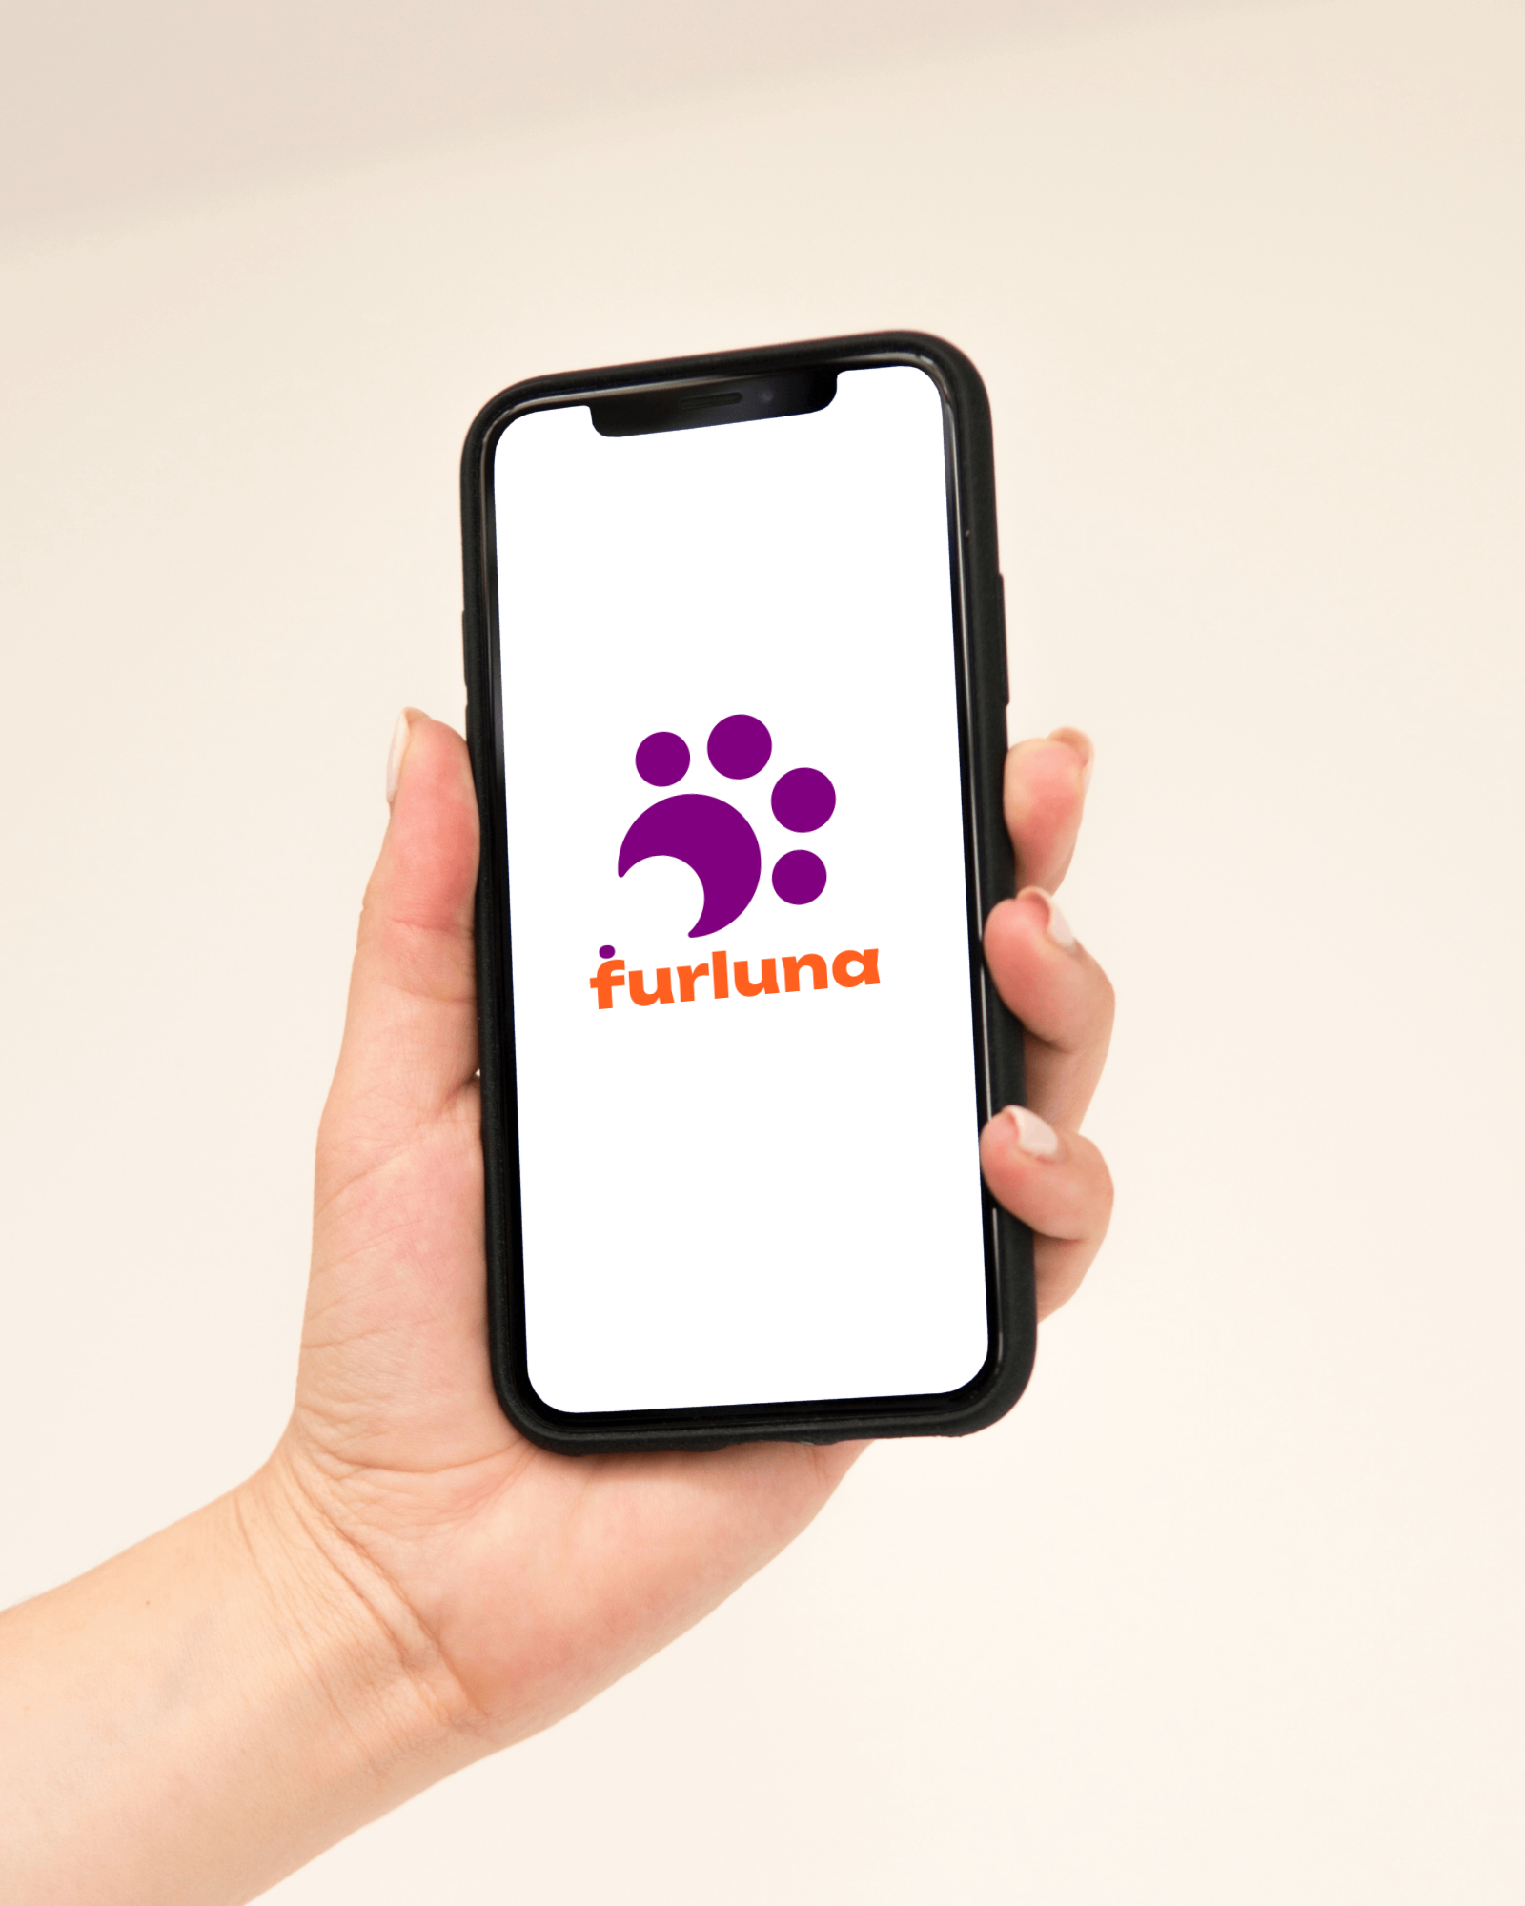
July 2024
furluna
JACKSHUB
.COM

Slide 2


Your Pet's Health Simplified

Slide 3

Problem
TRANSFER OF CARE & SECURITY
Transfer of care from one vet to another
Security of healthcare data

Slide 4

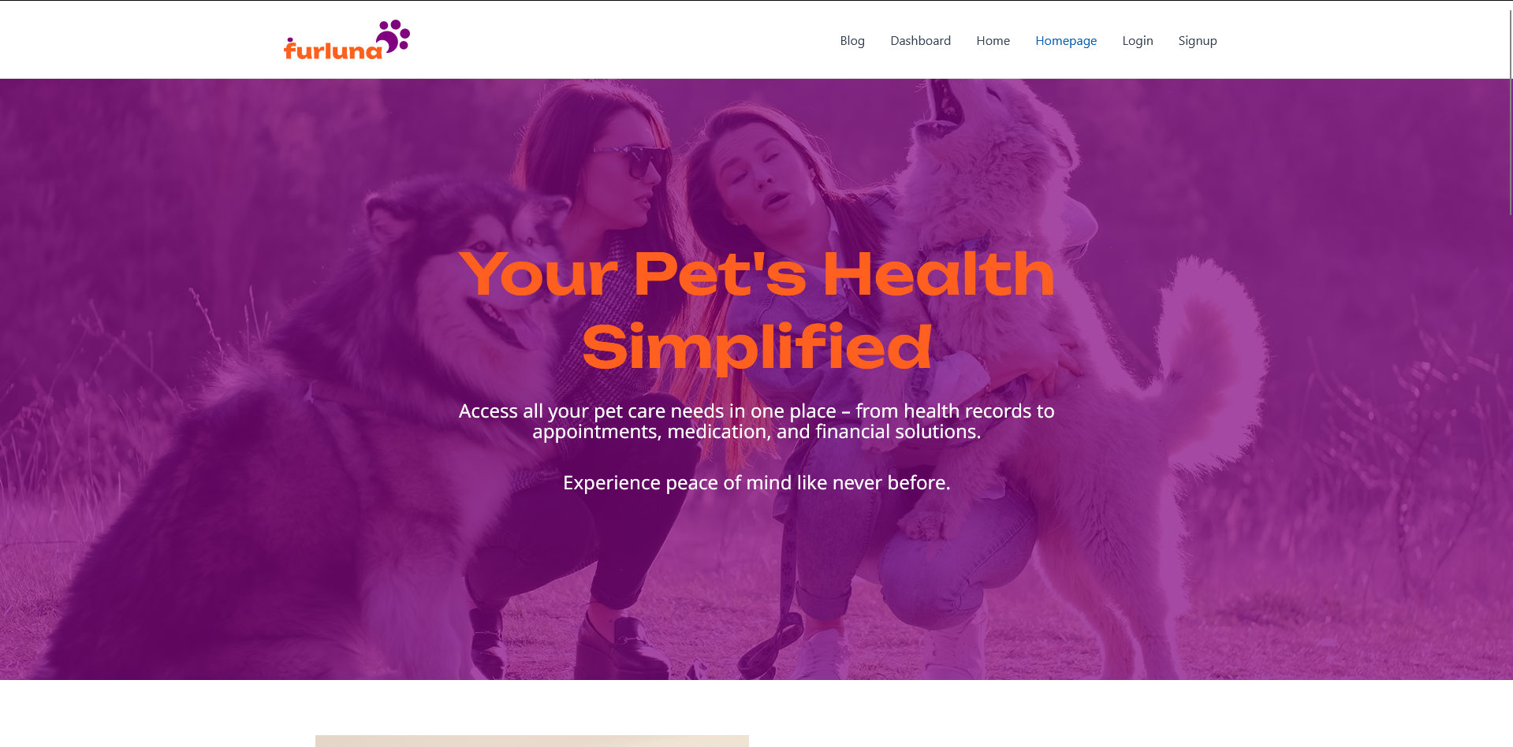
WELCOME
jackshub.com
Introducing our website for pet lovers

Slide 5




Features
PET PROFILE
SECURE DATA
APPPOINMENT & MEDICATION SCHEDULER
TELEMEDICINE
Keep a record of your pets, allowing veterinarians get a good grasp on your pet beforehand.
Get access to expert advice and tips from experienced veterinarians.
Your pet data is securely stored on the cloud with you in control.
Your next appointment is at your fingertips. Manage your pet's prescription.

Slide 6
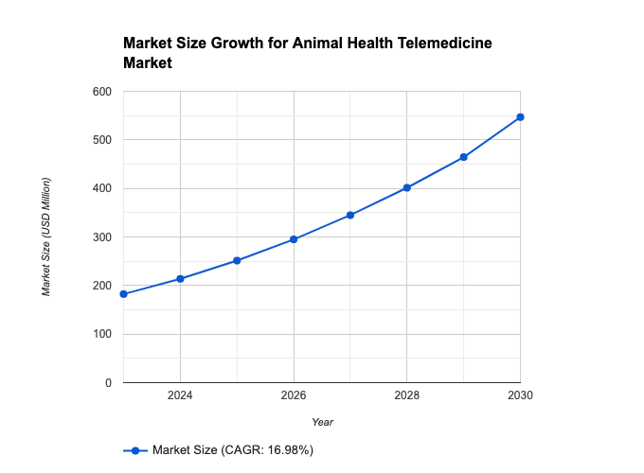
MARKET
Growing Demand for Pet-Related Online Services
Market Size - USD 510.49 Million by 2030
Source: Straits Research
Why?
Increasing pet owners globally
Increasing of Chronic health diseases among animals.

Slide 7




COMPETITION
Analyzing Competitors
Direct connection
furluna
Chewy
Complex Appointment Scheduling
VitusVet
Simple Appointment Scheduling
Rover
Analyzing key competitors in the pet website industry
Nondirect connection

Slide 8
Roadmap
May
Partnership with local pet stores for added convenience in purchasing pet supplies and medications
Apr
Implementation of user-requested features and improvements
Feb
Dec
Oct
Explore adding a feature to match pets with suitable vet providers
Launch of our site
Expansion to include more veterinary clinics and hospitals in various locations

Slide 9
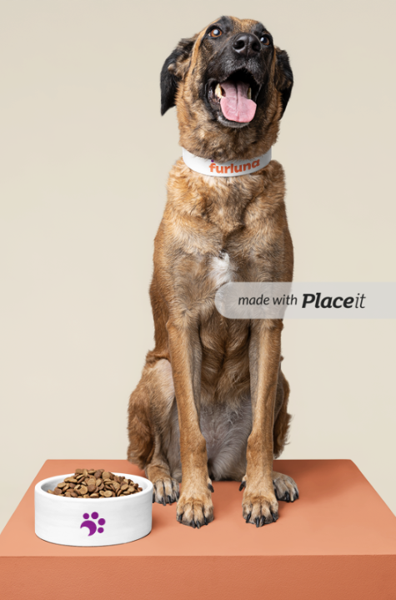


VOTE FOR US !
TEAM - KANJ
KRISTIAN, AYMANE, NILESH, JOHN

Slide 10



